Slide 1
Computer algorithm based medicine design
Group members: Ouyang chenxi,Xu chuanshi,Wu Haotian,Xing chengjie

Slide 2
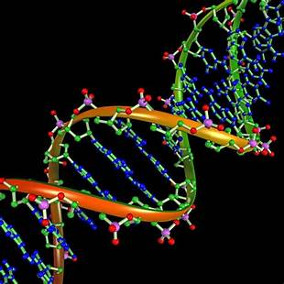
Introduction to Computer Algorithm-Based Medicine Design
Computer algorithm-based drug design refers to the use of various computational methods (such as machine learning, molecular modeling, and optimization algorithms) to identify potential drug candidates, predict their biological activity, and optimize their structures, all while reducing time and cost.

Slide 3
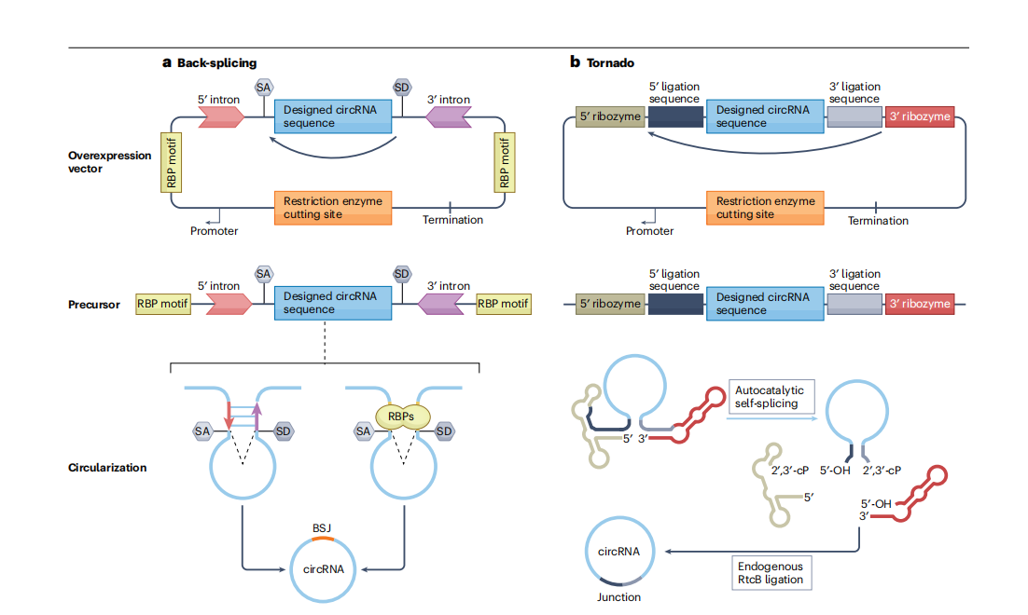
Benefits of Computer Algorithm-Based Medicine Design
Generated circRNA exhibited enhanced in vitro stability and protein expression
LPP delivery system efficiently delivered circRNA in vitro and in vivo
circDesign-generated circRNA rabies vaccine demonstrated superior in vitro sta_x0002_bility and in vivo performancet

Slide 4
Challenges and Limitations of Computer Algorithm-Based Medicine Design
focuses on a single coding sequence (CDS)
lack of chemically modified nucleotides
A primary limitation of the current work is that our optimization focuses on a single coding sequence (CDS)without further refinement of other critical regions, such as the IRES itself. At present, the de novo designof an efficient IRES motif is challenging because virally or cellularly derived IRES elements are generallysensitive to deletions, mutations, or insertions. Their multiple domains must remain properly folded to recruit the translation pre-initiation complex and assemble a functional ribosome. Consequently, we have not
yet incorporated direct design of the IRES region in circDesign.
To IRES-driven translation from circRNA, N6
-methyladenosine modification upstream of the
CDS has been reported to enhance both translation and stability 31. Although incorporating chemically
modified nucleotides could further broaden the potential of circRNA, we have not yet included these modifications in our current approach. Once explored and validated experimentally, such modifications can be
seamlessly integrated to optimize the design process.

Slide 5


Conclusion
Computer algorithm-based medicine design uses tools like molecular modeling, AI, and simulations to speed up drug discovery and reduce costs. It helps predict how drugs interact with targets, screen compounds, and design new molecules. While challenges like data quality and complexity remain, this method is becoming essential for developing faster, cheaper, and more personalized treatments.

